Slide 1
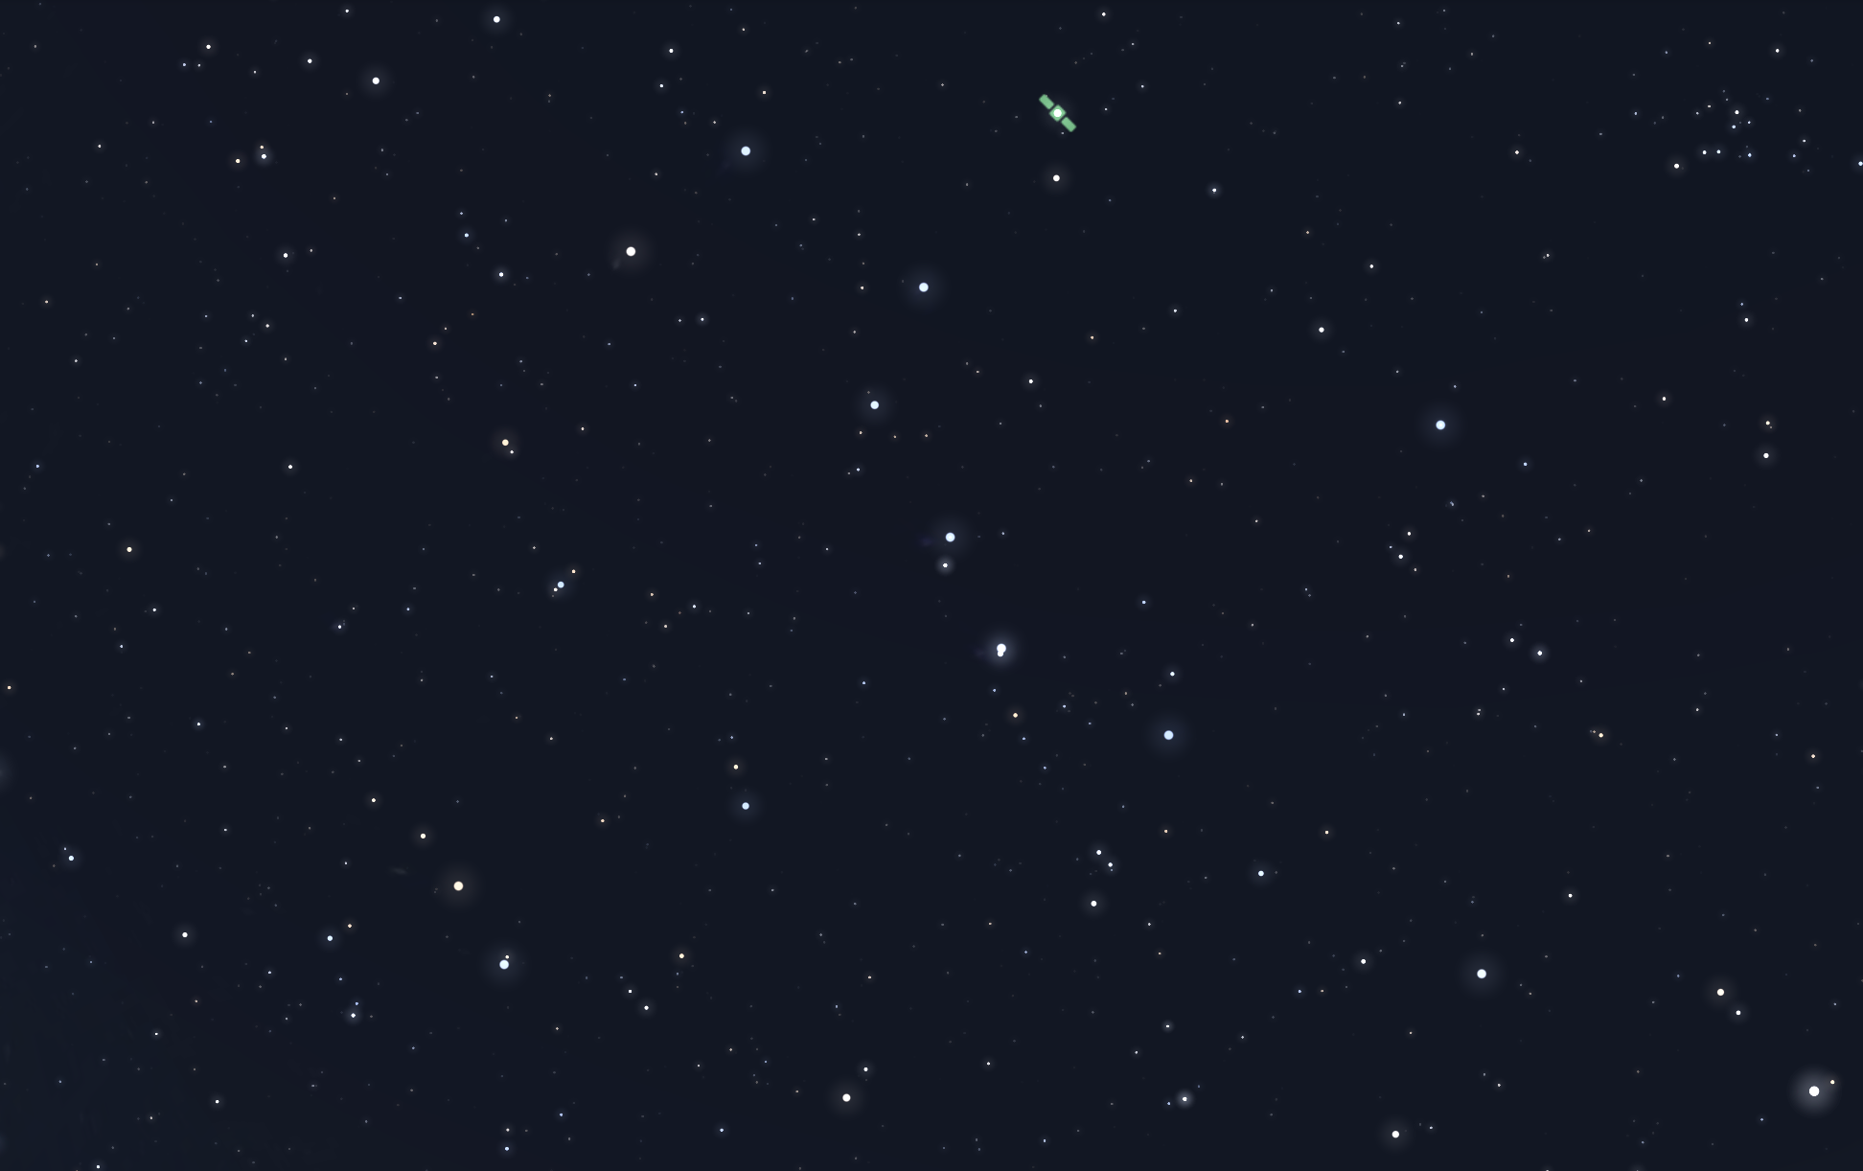
Star Matcher
Daniel Nazarenko, Omer Apter

Slide 2
Detecting Stars
Detecting stars is pretty straight forward, the easiest way that leads to good results is:
Iterate over the image pixels.
Flood fill each positions bright pixels and keep track of their (x, y).
Then:
Average the (x, y) of all the adjacent bright pixels found.
Average the brightness of the pixels.
Count the radius in pixels if needed.

Slide 3
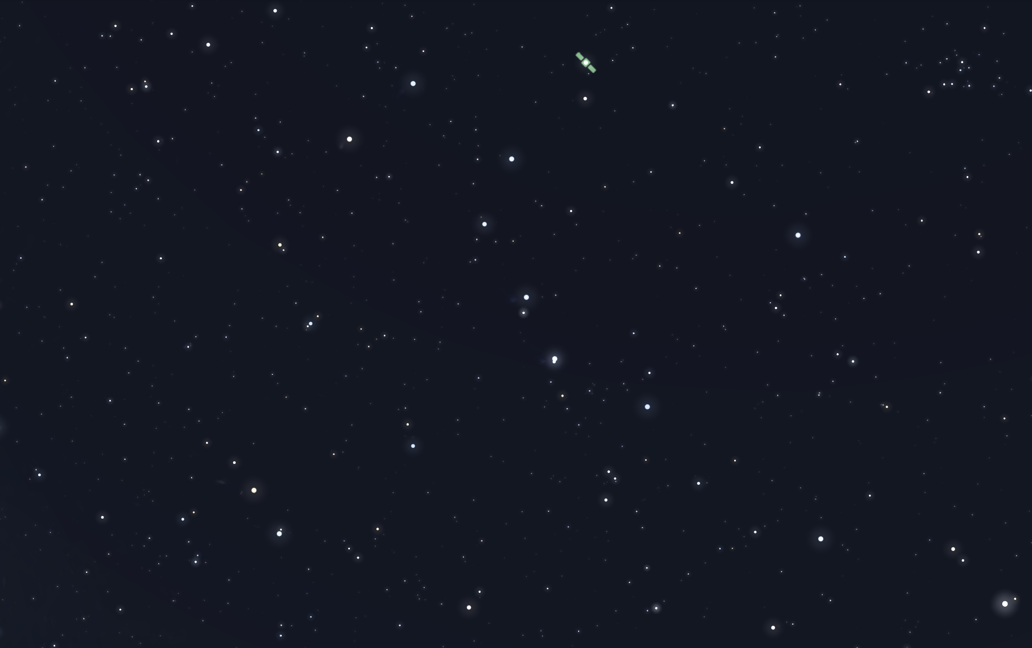

Slide 4
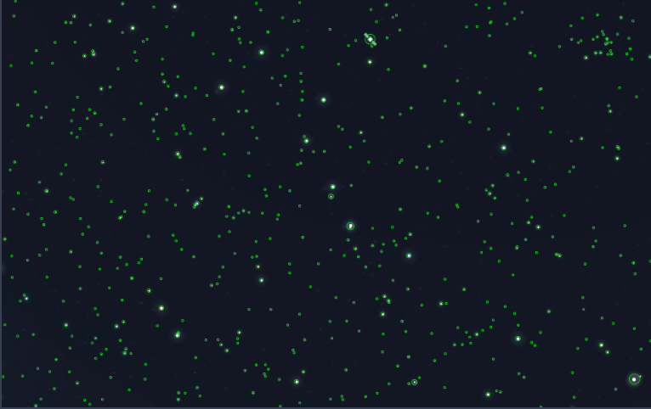

Slide 5
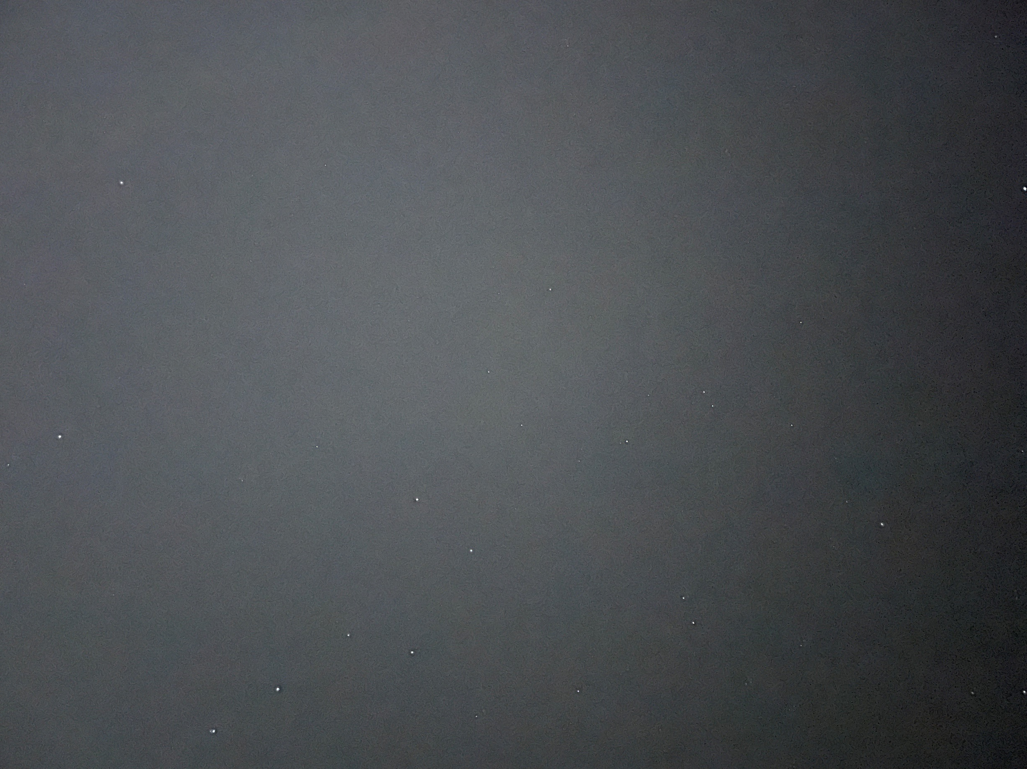

Slide 6
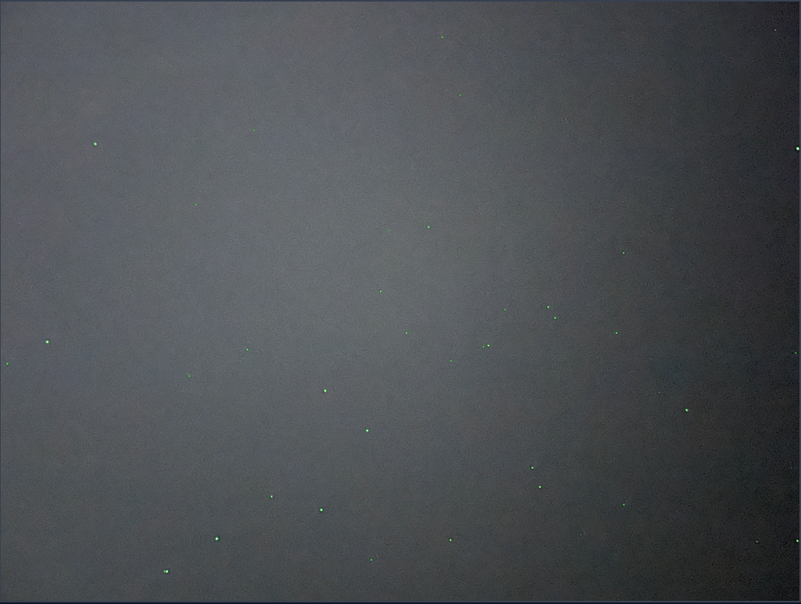

Slide 7
Matching Stars
Matching stars between images / between an image and a star catalog is theoretically easy,
the first step is the find a way to identify matches between groups:
Build geometric features between the stars, the two popular ones are:
Triangular – Build triangles from groups of 3 stars and keep track of the distances.
Quadrilateral – Build shapes from groups of 4 stars and keep track of distances + angle.

Slide 8
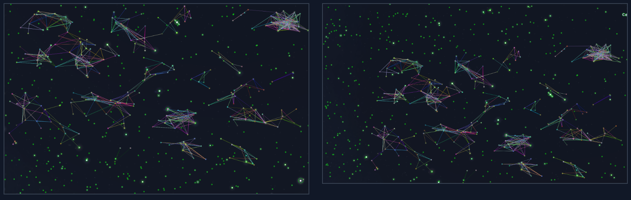
Matching Stars – From exercise one

Slide 9
Matching Stars - Hashing
Comparing so many shapes take a LOT of time, an easy fix is the split the stars into grids and build shapes only in said grids.
Another fix for fast searching is hash all the shapes by their identifiers, for example a
triangle of stars with edge length of 3, 4, 5 will be normalized by the longest edge to
become: 0.6, 0.8, 1 and then hashed to become something like “0.6:0.8”.
This will allow for fast comparison between the stars in the catalog and the stars in th
image.

Slide 10
Matching Stars - Hashing
Finding one match between images isn’t enough because its only comparing 2 values,
there can be a lot of false positives.
A good way to fix this issue is to calculate an expected scale when an optional match is
found. Then for each other match check if the scale also matches, if not – discard the
answer.

Slide 11
Matching Stars - Problems
To create the geometric features, we need a 2D plane, with images there isn’t any issue but with stars in a catalog, that are stored on a sphere, there are.
Usually, to fix the issue each evaluated group of stars needs to be projected onto a 2D plane (like unwrapping a candy) this can and will cause slight errors that won’t allow the shapes to be made correctly as seen from earth.
The fix is to use high level math and place a “camera” that looks at every group, project the stars using the camera and than continue the calculations.

Slide 12
Astronomy.net
This is an open-source project, website, and API with a catalog of ~100 million known
stars that allows the user to upload an image, it will then identify all the stars and the
star systems and store the output on the server for the user to read.
The API doesn’t have any restrictions and can be found by signing up here:
https://nova.astrometry.net/api_help

Slide 13
Astronomy.net
Using the api is pretty un intuitive so we built a tool for that:
1. Start by importing the python files on:
https://github.com/daniel-naz/astronomy
Run “python main.py” than follow the instructions.
Or run “python main.py –a [api] –f [input_file] –o [output_file]”.

Slide 14
Astronomy.net – Examples
Save an image “temp.png” – the one on the right
Run: python main.py –a apikey –f temp.png –o out.png
After waiting some time, the output file will be stored
and the following link will be printed:
Link

Slide 15
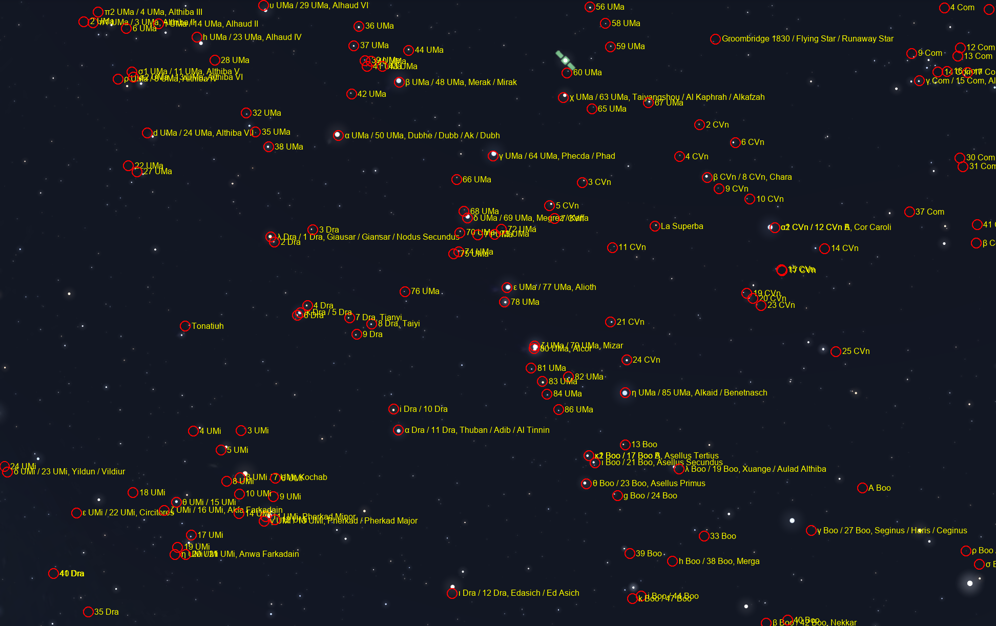

Slide 16
Astronomy.net – More Generally
The tool allows to receive a list of stars that match the one in the picture using a
simple program of:
import astrometry_client as ac
session = ac.login(API_KEY)
subid = ac.submit_file(session, FILE_PATH)
jobid = ac.get_job_id(subid, timeout)
ac.await_job(jobid, timeout)
annotations = ac.fetch_annotations(jobid)

Slide 17
The End
Daniel Nazarenko, Omer Apter

